Slide 1
OCTOBER RELEASE CYCLE
2012
Processes/Information Update

Slide 2
Some common Terms:
Scope Sheet
Data or Cross
Unit Test Script
User/Integration Test Script
Data Issue Log (OLAP and OLTP)
SVN Update
Creating DTD from FDs and how to fill
Links for: SharePoint, JTI Deliverables, Incidents, Defects, DTD
Notes:
Show them where to find templates
Explain the different terms

Slide 3
Change Request/Incidents Life Cycle
As described below, the following stages must
be adhered when working on change requests
and incidents. The stages are:
Analysis
Business Approval (GDC Side)
Development
Pending for Peer Review
Ready in DEV
Note: We have two types of CR/Incidents:
Data : Only the data team is impacted
Cross: All 3 teams or 2 teams may be impacted (Sales, Data and OBIEE)
Notes:
Explain the life cycle of CR/INCS. Afterwards we have defects and incidents
What happens when CR/INCS is cross or data. What documents are used?

Slide 4
Step 1: Analysis
The analysis can be done at:
High level
A high level information on the changes that should be done as per FD (Funtional details provided).
Example:
Detailed level
All impacted mapping and detailed information on the changes that should be done
are provided. All these details are provide in a DTD (Detailed Technical
Design) which is sent to GDC for validation and approval.
Note:
1.The DTD document is versioned. Each time a FD provided, we
have to create a new version of the DTD.
2. We have to provide the effort estimated to implement CR. Normally the approximate
Man days are:
Examples:
1 ETL: 0.65
1 Loader: 0.85
3. Sharepoint Update:
Data Development Status = Estimates Ready
Effort Estimated = Total Effort Estimated as per DTD
Data Assigned Person = GDC Siebel (Enrique, Miguel or Jaime)
Notes:
Show where document templates are kept
Show examples of different DTD versions

Slide 5
Step 2: Business Approval
Once we have estimated the effort with the DTD, we assign change request
or incident to GDC to validate. During this process, we may have to re-adjust
DTD and effort estimated based on feedback from GDC.
Some scenarios are:
GDC does not approve total effort estimated (over-estimated)
Some new requirements due to change in FD
Some unforeseen requirement linked to other CR
Finally, when GDC approves DTD provided for CR or Incident, it is assigned
back to MRU.

Slide 6
Step 3: Development Phase
Change Request assigned back to MRU in development phase:
When starting the development, the developer must update SharePoint:
Data Development Status = In Progress
Data Assigned Person = Grimont, Arnaud
Secondly, the approved DTD must be used and there are specific guidelines that
Should be followed as per document sent by Arnaud.
Finally, at the end, the developer must ensure that:
A folder for the CR/INC is available release folder as follows:
Place the unit test script in the Build Folder inside the change request/Incident
Commit the stored procedures on SVN, IFB files or any associated documents.
Update data Issue log
Sharepoint Update:
Data Development Status = Pending for Peer Review
Effort Consumed = Total Effort Consumed by developer
Data Assigned Person = Grimont, Arnaud
Notes:
In case CR is estimated for more than 1 man days, the field Effort Consumed must be updated on a daily basis with the current effort consumed so far.
HLFD , DD for ETL DEV

Slide 7
Step 4: PEER REVIEW PROCESS
After a CR/INC status passes to “Pending for Peer Review”, another person will be
assigned to test the development done. The tester will use the unit test scrip that the
developer has made and review the development.
Note: The user test script must be detailed with all the steps, sql query, OBIEE Xml and
any other steps that were used during testing. You must assume that a novice
is doing the testing and is following the steps that you have detailed and not to
forget the screenshots.
At this point we have 2 scenario:
Review of test script successful
Review failed
In case of Scenario 2, the reviewer will inform the developer that the review has failed and the developer
has to perform the corrections and inform the reviewer when its ready for to be reviewed again.
Upon successful review, the tester has to:
Produce a user test script or integration test script
Place the test script in folder test script to validate to be picked by Philippe
Sharepoint Update:
Data Development Status = Ready in DEV
Effort Consumed = Total Effort Estimated
Data Assigned Person = Grimont, Arnaud
Notes:
CR will be assigned to GDC after release completed successfully
There are scenarios when the Effort consumed can be less than or greater than the Effort estimated

Slide 8
5. READY IN DEV
When the review has passed, the total effort consumed (should be
equal to effort estimated in analysis phase) is updated and the status of
the CR/ INC changes to READY IN DEV.
After the planned release, the CR is assigned to GDC.
WHAT HAPPENS NEXT?

Slide 9
DEFECTS
Now after successful release and testing, its
possible that we have errors because of:
New Requirements (Unforseen ,Admin, Functional, Interface)
Admin Issue
User Test Script
Bug
Users Action
In such cases, market will create a defects where appropriate investigations have
to be done to investigate and fix issues accordingly.
When working on defects, its very important to update SharePoint:
Set status = In Progress when starting to work on defect
Once root caused analyzed, change category, add update and assign back to GDC Siebel group
Notes:
Explain each of this scenarios

Slide 10
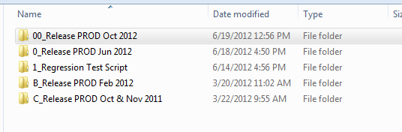
Scope Sheet
Where it is found?
J:\TME_JTI_PROJECT\1) General\4_RELEASE_MANAGEMENT
Next browse to 00_Release PROD Oct 2012\01_Management\Data Scope
Select release folder

Slide 11
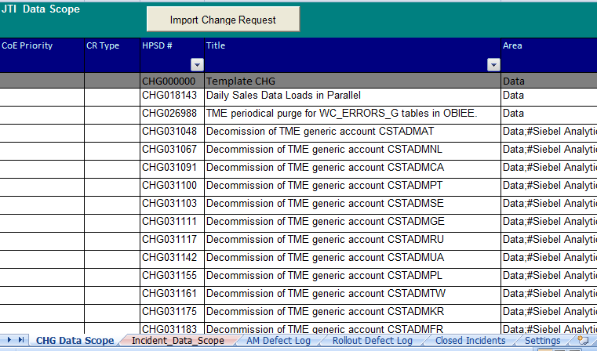
2. Updating Scope Sheet
2. 1 What to update?
The same scope sheet is used for changes requests, incidents, defects are all done
in the same scope sheet by choosing the required tab.
Select the required Tab that you want to update
The different category items for the data stream

Slide 12
2.2 Fields that should be updated
Important changes are tracked through scope sheet such as:
1. WHO?
Ex: Who has worked on the incidents >> EPM assignment
2. WHAT was done?
Ex: What was done to fix issue?
3. WHEN was it done?
Ex: During which release this was fixed ?
Note: Incidents are normally assigned to Vikram Seeburn when assigned to MRU team with the group TME-DATA-INTERFACES

Slide 13
Next, the important fields that MUST be filled are:
EPM Assigned Person: who has worked on the incident.
Release Dependant : If fix required should is release dependant.
Question: What do you understand by release dependant
Data Update Required: Y or N: Based on the fix to be done if any data update required as post task
Test Script Required: Y or N. Based on the fix done, a user test script must be provided.
Note: Applicable for release dependant incidents
Technical Solution in the format :
[20120621:LK] Change mapping to transfer AB values from OLTP to OLAP (understandable description)
MRU STATUS in the format :
[20120621:LK] DEV currently in progress in MRU
Notes:
Add NRA when more than one resource has worked on INC or CHG or Defects

Slide 14
Updating Scope Sheet
Peer Review Name: Some fixes done and usually for release dependant incidents, the DEV must be peer reviewed before assigned to GDC for testing.
Review date: The date that the peer review was done.

Slide 15
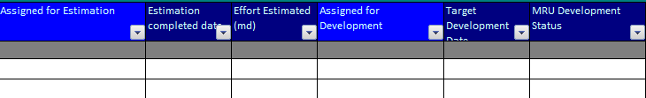

Updating Scope Sheet
Change Requests Impacted Fields
Name of person doing Analysis
Total man days estimated
Name of person doing development
Should have Friday’s date
Y only if data update required
Name of person assigned for review
Description of current progress in the form: [20120621:LK] DEV in progress
Date
reviewed

Slide 16
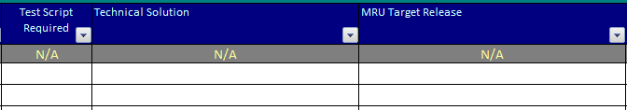
Updating Scope Sheet
Incidents Impacted Fields
Mandatory for all CR and Incidents
Description of technical solution that was done to resolve issue
When will it be release? Ex: UAT 1, UAT 2….

Slide 17
RELEASE DEPENDANT/ HOT FIX Incidents
All incidents that are hot-fixed or classified as release dependant, the
following processes must be followed:
Prepare a DTD and sent for GDC for validation.
Once DTD is approved, we proceed with development in DEV.
Prepare unit test script
Log Data Issue log, SVN and prepare data update and add to post release tasks if required
Review CR or Incident and make user/Integration test script
SharePoint and scope sheet update

Slide 18
3. SharePoint UPDATE
3. 1 Select tab to update
Link to SharePoint:
http://moss.jti.com/sites/TME/Testing/Lists/Oct12%20Release%20Log/AllItems.aspx
The different stages of a CR are:
Analysis : For analysis & estimation period, i.e. . DTD preparation
Estimates Ready: Once DTD is ready for validation
Business Approval : GDC approves DTD and CR goes into DEV
Pending for Review : DEV completed and CR is ready to be reviewed
Ready in UAT: Both DEV and Peer review completed
Rejected: CR was rejected
More Info Needed: When FD is not clear or we require additional details from COE, we re-assign CR with appropriate description and set status to More Info Needed.

Slide 19
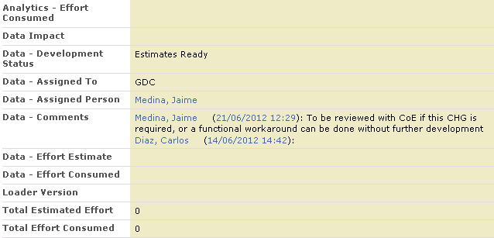
SharePoint UPDATE
WHEN?
On a daily basis.
WHAT to update?
Total Effort Burnt, Development Status, short description of current status.
Always assigned to Arnaud for MRU
Effort estimated as per analysis done

Slide 20
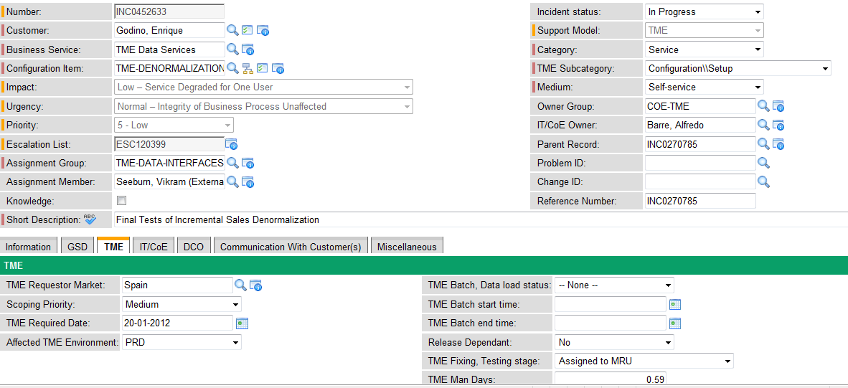
4. INCIDENT UPDATE
WHEN?
On a daily basis.
WHAT to update?
Once you start working on an incident, we update incident and change TME Fixing, Testing Stage to “Work in Progress in MRU”
By default should be set to No (Initially None)
Important field, should be updated accordingly

Slide 21
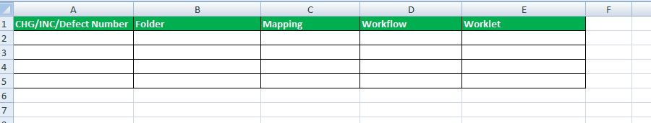
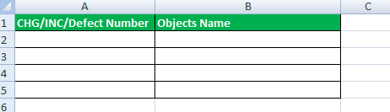
Update Impacted Object Document
This document need to be updated by the Developer of the Change
Request/Incident or Defect to include the impacted Object per change request.
You will have 3 distinct section that need to be filled as follows:
INFORMATICA
IFB/ PHP/JAVA PARAMTER FILES ETC

Slide 22
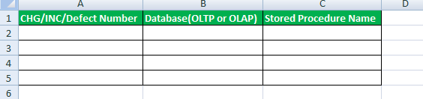
3. IFB/ PHP/JAVA PARAMTER FILES ETC
Document Path:
J:\TME_JTI_PROJECT\1) General\4_RELEASE_MANAGEMENT\00_Release PROD Oct 2012\04_Release Docs\003-Data\ Oct_2012_Data_Impacted_Objects.xlsx

Slide 23
IMPORTANT LINKS
Service Now
https://biz2.jti.com/SecureSSO/Default.aspx?nav_to.do?uri=incident.do%3Fsys_id=8f2a4309ff706c40a2ad8ffb97649d41%26sysparm_stack=incident_list.do%3Fsysparm_query=active=true
Sharepoint
http://moss.jti.com/sites/TME/Testing/Lists/Oct12%20Release%20Log/AllItems.aspx
JTI Deliverables
http://moss.jti.com/sites/TME/it/Release%20Deliverables/Forms/ALLITEMS.aspx
Process and Templates Documents
J:\TME_JTI_PROJECT\1) General\4_RELEASE_MANAGEMENT\00_Release PROD Oct 2012\00_Process & Templates
Data Issue Log
svn://10.186.26.11:443/Phase II/TME_Phase_2_AM/10_Data_Issue_Log/UPGRADE
HLFD Documents
svn://10.186.26.11:443/Phase II/EIM/08 - Interface 08/HLFD-Upgrade

Slide 24
Impacted Object Document
J:\TME_JTI_PROJECT\1) General\4_RELEASE_MANAGEMENT\00_Release PROD Oct 2012\04_Release Docs\003-Data\ Oct_2012_Data_Impacted_Objects.xlsx

Slide 25
QUESTIONS ?

